Slide 1

Business Planning and Budgeting 2021
Ayushi Consultancy, LLC

Slide 2



Agenda
Financial Analysis Overview
Expenses
Revenue
Net Revenue Margins and % Margins

Slide 3




Introduction
With PowerPoint, you can create presentations and share your work with others, wherever they are. Type the text you want here to get started. You can also add images, art, and videos on this template. Save to OneDrive and access your presentations from your computer, tablet, or phone.

Slide 4
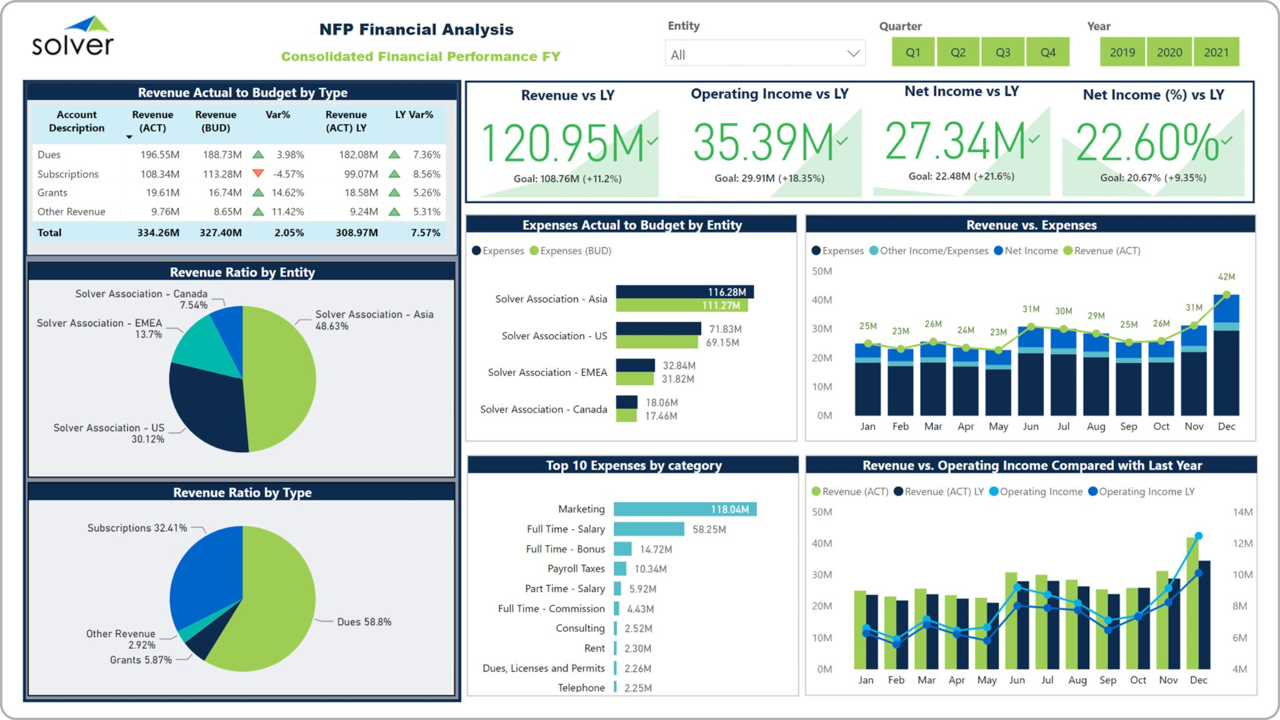








Slide 6
Conclusion- Revenue by Type (Yearly)
Majority comes from Financial Activities and Grants
Donations make up 10%
Grow donations by advertising on social media, website, ask on-site
Marketing by creating pamphlets or flyers
Continue to increase revenue by getting more grants and developing financial activities

Slide 7
Conclusion- Revenue vs. Expenses
Currently equal revenue and expenses for the year 2021
Expenses are around $3000
Most comes from Net Revenue (2)-Continue to grow
Decrease expenditure as much as possible

Slide 8
Conclusion- Expenses (Yearly)
Rent accounts for most of the yearly expenses
Top 5: Rent, supplies, stipend payroll, transportation, financial activities
To reduce Top 5: Find a new building with lower rent/utilities, alternative or cheaper supplies (Aldi), reduce payroll, carpooling option, alternative with lower interest rates
Since there is a large repairs expense- purchase better quality items
Cleaning and Maintenance- try alternative such as Todoolie

Slide 11

Expenses
Subtitle

Slide 20
Expenses | Month 1 | Month 2 | Month 3 | Month 4 | Month 5 | Month 6 | Month 7 | Month 8 | Month 9 | Month 10 | Month 11 | Month 12
Rent | $ 1,000 | $ 1,000 | $ 1,000 | $ 1,000 | $ 1,000 | $ 1,000 | $ 1,000 | $ 1,000 | $ 1,000 | $ 1,000 | $ 1,000 | $ 1,000
Insurance | $ 50 | $ 50 | $ 50 | $ 50 | $ 50 | $ 50 | $ 50 | $ 50 | $ 50 | $ 50 | $ 50 | $ 50
Financing Activities - Interest Expense | $ 167 | $ 167 | $ 167 | $ 167 | $ 167 | $ 167 | $ 167 | $ 167 | $ 167 | $ 167 | $ 167 | $ 167
Legal & Professional Services [incl Marketing] | $ 100 | $ 100 | $ 100 | $ 100 | $ 100 | $ 100 | $ 100 | $ 100 | $ 100 | $ 100 | $ 100 | $ 100
Licenses & Permits | $ 20 | $ 20 | $ 20 | $ 20 | $ 20 | $ 20 | $ 20 | $ 20 | $ 20 | $ 20 | $ 20 | $ 20
Stipend/Payroll | $ 400 | $ 400 | $ 400 | $ 400 | $ 400 | $ 400 | $ 400 | $ 400 | $ 400 | $ 400 | $ 400 | $ 400
Transportation | $ 300 | $ 300 | $ 300 | $ 300 | $ 300 | $ 300 | $ 300 | $ 300 | $ 300 | $ 300 | $ 300 | $ 300
Labor/Administration | $ 20 | $ 20 | $ 20 | $ 20 | $ 20 | $ 20 | $ 20 | $ 20 | $ 20 | $ 20 | $ 20 | $ 20
Cleaning & Maintenance | $ 100 | $ 100 | $ 100 | $ 100 | $ 100 | $ 100 | $ 100 | $ 100 | $ 100 | $ 100 | $ 100 | $ 100
Repairs | $ 100 | $ 100 | $ 100 | $ 100 | $ 100 | $ 100 | $ 100 | $ 100 | $ 100 | $ 100 | $ 100 | $ 100
Supplies - [Materials /Food/snacks/etc.] | $ 500 | $ 500 | $ 500 | $ 500 | $ 500 | $ 500 | $ 500 | $ 500 | $ 500 | $ 500 | $ 500 | $ 500
Utilities - Electric | $ 100 | $ 100 | $ 100 | $ 100 | $ 100 | $ 100 | $ 100 | $ 100 | $ 100 | $ 100 | $ 100 | $ 100
Utilities - Gas | $ 75 | $ 75 | $ 75 | $ 75 | $ 75 | $ 75 | $ 75 | $ 75 | $ 75 | $ 75 | $ 75 | $ 75
Utilities - Sewer | $ 20 | $ 20 | $ 20 | $ 20 | $ 20 | $ 20 | $ 20 | $ 20 | $ 20 | $ 20 | $ 20 | $ 20
Utilities - Trash | $ 20 | $ 20 | $ 20 | $ 20 | $ 20 | $ 20 | $ 20 | $ 20 | $ 20 | $ 20 | $ 20 | $ 20
Utilities - Water | n/a | n/a | n/a | n/a | n/a | n/a | n/a | n/a | n/a | n/a | n/a | n/a
Utilities - Website Hosting | $ 20 | $ 20 | $ 20 | $ 20 | $ 20 | $ 20 | $ 20 | $ 20 | $ 20 | $ 20 | $ 20 | $ 20
Utilities - Internet Access | $ 20 | $ 20 | $ 20 | $ 20 | $ 20 | $ 20 | $ 20 | $ 20 | $ 20 | $ 20 | $ 20 | $ 20
Utilities - Telephone | $ 75 | $ 75 | $ 75 | $ 75 | $ 75 | $ 75 | $ 75 | $ 75 | $ 75 | $ 75 | $ 75 | $ 75
Other/Misc | $ 100 | $ 100 | $ 100 | $ 100 | $ 100 | $ 100 | $ 100 | $ 100 | $ 100 | $ 100 | $ 100 | $ 100
Net Expense | $ 3,187 | $ 3,187 | $ 3,187 | $ 3,187 | $ 3,187 | $ 3,187 | $ 3,187 | $ 3,187 | $ 3,187 | $ 3,187 | $ 3,187 | $ 3,187 | $ 38,240

Slide 21
Expenses Discussion
Subtitle
31% of the expenses is Rent

Slide 29
Revenue | Month 1 | Month 2 | Month 3 | Month 4 | Month 5 | Month 6 | Month 7 | Month 8 | Month 9 | Month 10 | Month 11 | Month 12
Donations [Direct] | $ 417 | $ 417 | $ 417 | $ 417 | $ 417 | $ 417 | $ 417 | $ 417 | $ 417 | $ 417 | $ 417 | $ 417
Donations [Web] | $ 417 | $ 417 | $ 417 | $ 417 | $ 417 | $ 417 | $ 417 | $ 417 | $ 417 | $ 417 | $ 417 | $ 417
Grants | $ 4,167 | $ 4,167 | $ 4,167 | $ 4,167 | $ 4,167 | $ 4,167 | $ 4,167 | $ 4,167 | $ 4,167 | $ 4,167 | $ 4,167 | $ 4,167
Net Revenue (1) | $ 5,000 | $ 5,000 | $ 5,000 | $ 5,000 | $ 5,000 | $ 5,000 | $ 5,000 | $ 5,000 | $ 5,000 | $ 5,000 | $ 5,000 | $ 5,000 | $ 60,000
Financing Activities | $ 4,167 | $ 4,167 | $ 4,167 | $ 4,167 | $ 4,167 | $ 4,167 | $ 4,167 | $ 4,167 | $ 4,167 | $ 4,167 | $ 4,167 | $ 4,167
Net Revenue (2) | $ 9,167 | $ 9,167 | $ 9,167 | $ 9,167 | $ 9,167 | $ 9,167 | $ 9,167 | $ 9,167 | $ 9,167 | $ 9,167 | $ 9,167 | $ 9,167 | $ 110,000

Slide 30
Revenue Discussion
Subtitle
subtitle
subtitle

Slide 31
Net Revenue Margin
Subtitle

Slide 37
 | Month 1 | Month 2 | Month 3 | Month 4 | Month 5 | Month 6 | Month 7 | Month 8 | Month 9 | Month 10 | Month 11 | Month 12
Margin - [Net Revenue (1)] | $ 1,813 | $ 1,813 | $ 1,813 | $ 1,813 | $ 1,813 | $ 1,813 | $ 1,813 | $ 1,813 | $ 1,813 | $ 1,813 | $ 1,813 | $ 1,813 | $ 21,760
Margin % - [Net Revenue (1)] | 36.27% | 36.27% | 36.27% | 36.27% | 36.27% | 36.27% | 36.27% | 36.27% | 36.27% | 36.27% | 36.27% | 36.27%
Margin - [Net Revenue (2)] | $ 5,980 | $ 5,980 | $ 5,980 | $ 5,980 | $ 5,980 | $ 5,980 | $ 5,980 | $ 5,980 | $ 5,980 | $ 5,980 | $ 5,980 | $ 5,980 | $ 71,760
Margin % - [Net Revenue (2)] | 65.24% | 65.24% | 65.24% | 65.24% | 65.24% | 65.24% | 65.24% | 65.24% | 65.24% | 65.24% | 65.24% | 65.24%

Slide 38
Net Revenue Margin Discussion
Subtitle
subtitle
subtitle

Slide 39

Summary
Presented financial data via visuals (graphs, tables)
Suggestions/conclusions on reducing expenses and increasing revenue
Gave ideas on how to present data in different visuals and formats
Next steps to create visuals to include 2022 data and budgeting information

Slide 40


Thank You
Presenter name
Email address
Website address

